Slide 1

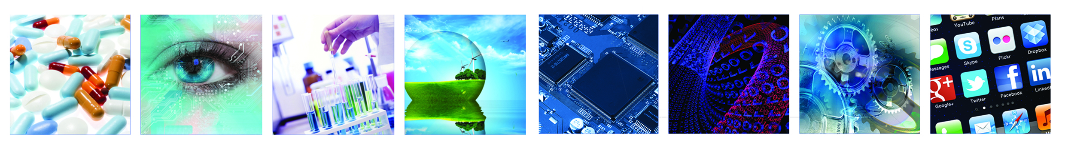
2nd IATI MNC Weekathon
Demo Day

Slide 2
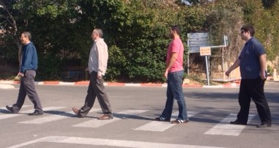



Blind-Phone Project
Adi Eldar
Microsoft ILDC
Shai Rubin
Citi Innovation Lab
Kfir Tishbi
Citi Innovation Lab
Igor Lyakas
GE HealthCare

Slide 3
Blind Phone – Background
We were looking for
Social purpose
Image processing
Mobile application
Idea: Use everyday device to help the blind. Challenge: crossing a road without guiding dog without voice assistance

Slide 4
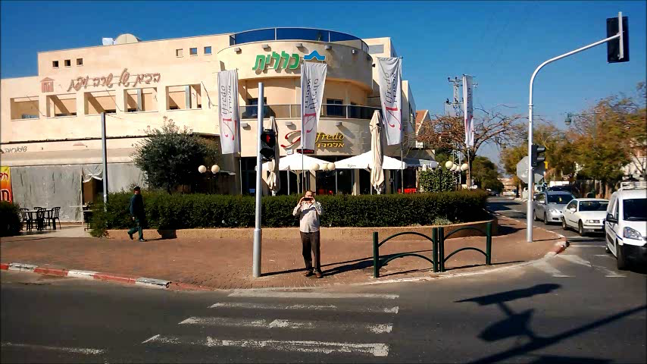
The Blind Phone Use Case

Slide 5
Kfir Placeholder

Slide 6
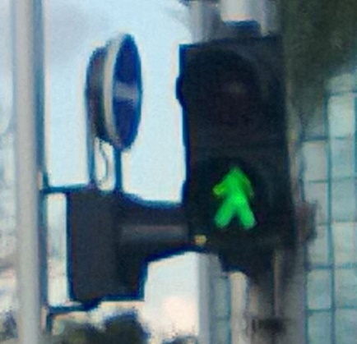
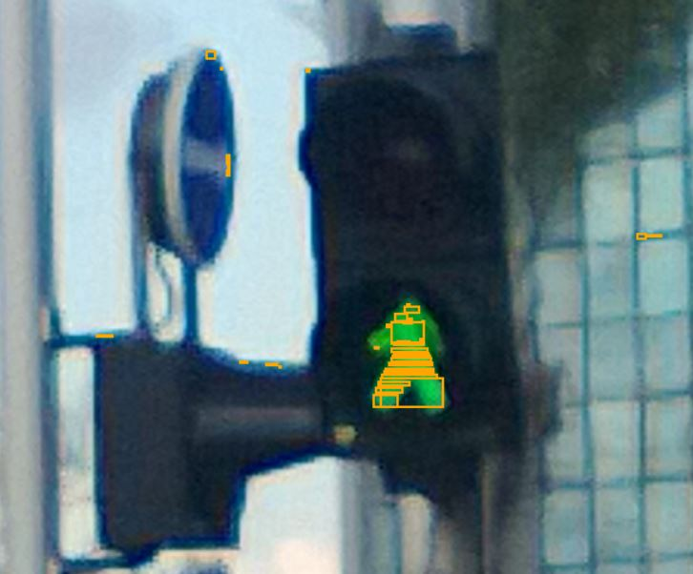
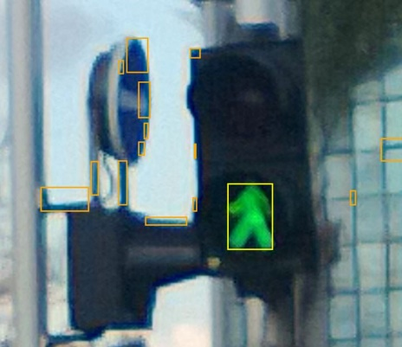
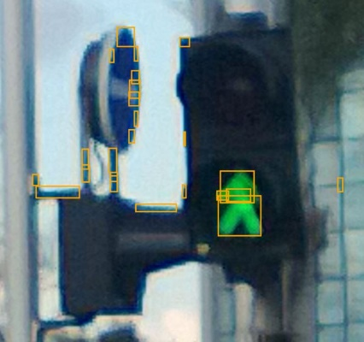
Image Processing Algorithm – Work Flow
Initial Traffic light Image
Find Red or Green Color Ranges
Group Adjacent Objects
Dilate the Objects

Slide 7
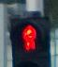
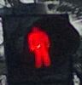
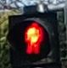
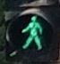
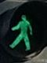
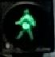
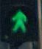
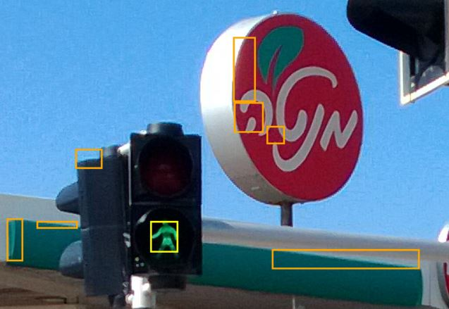
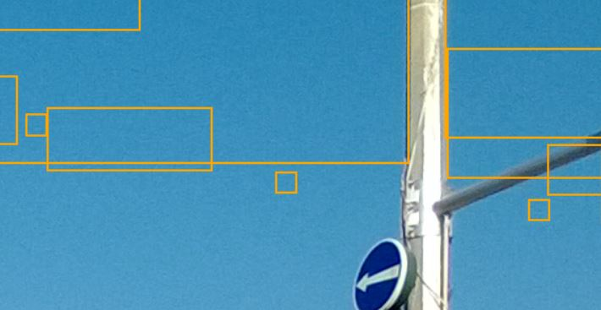
Image Processing Algorithm – Color Ranges
RGB Color Range varies, mainly due to Day Light and Shading
Requires to expand Red and Green Color Ranges to search in the image
Leads to finding other objects that fall into the searched range.
Sometimes, even sky.

Slide 8
Adi Placeholder

Slide 9
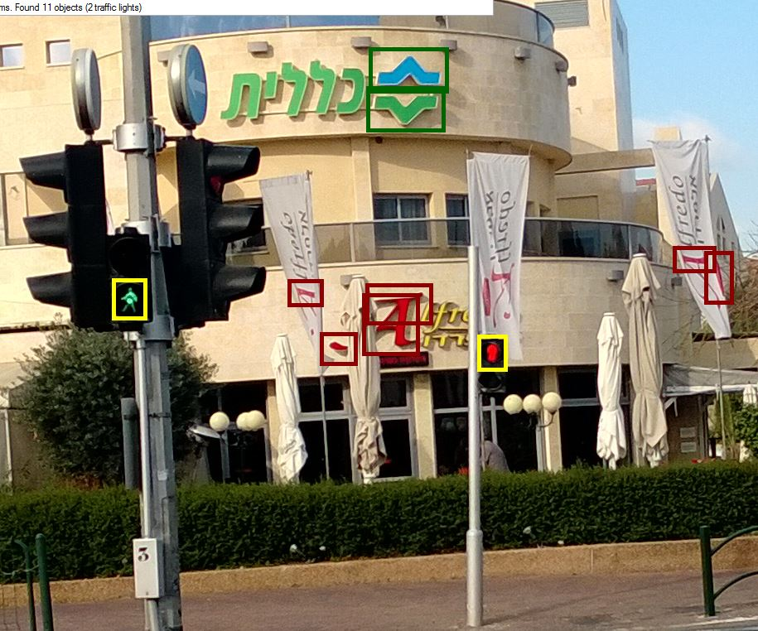
Summary – Blind Phone
Proud on the social goal
Proud on the team work
Proud on working POC
Thanks for RedHat !!
Thanks for IATI for arranging Developer Heaven:
Work on the problem you choose
With professionals
With recent technologies

